Slide 1
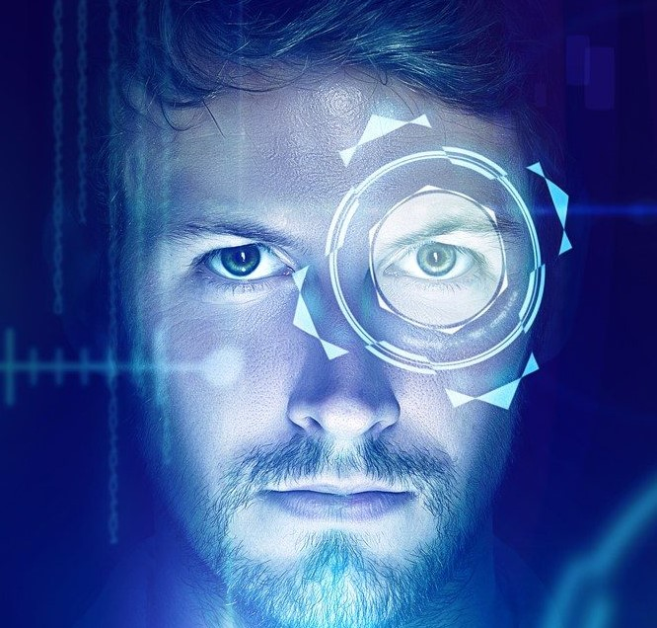
Welcome to our project
face recognition and attendance system software
PREPARED BY:-
Kamal Kalra
(uni.no.:- 10721840413)
Jasdeep Kaur
(uni.no.:- 10721840462)

Slide 2
acknowledgement
We would like to express my special thanks of gratitude to my teachers and as well as our respected principle who gave me the golden opportunity to do this wonderful project on “FACE RECOGNITION AND ATTENDANCE SYSTEM SOFTWARE”. They help me in doing a lot of research and I come to know about so many new things. Secondly I would like to thank my team mate who helped me a lot in finishing this project with the limited. It helped me to increase my knowledge and skills

Slide 3

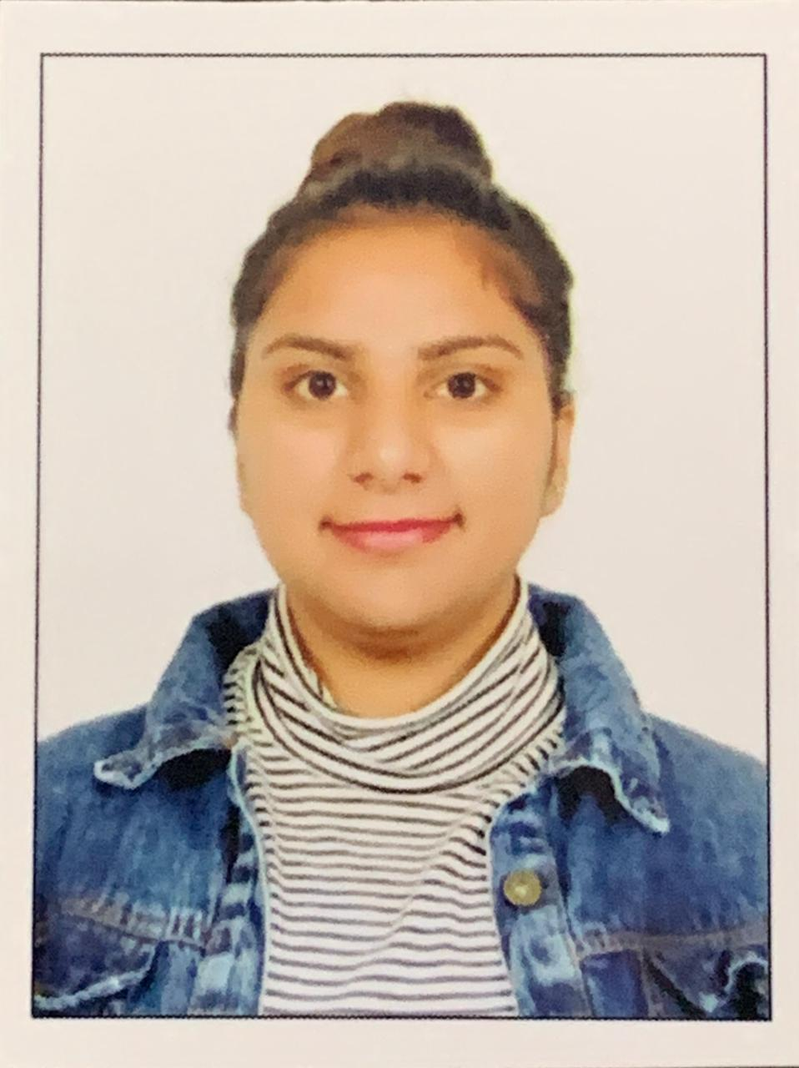
Developer of this python project
Kamal Kalra
BCA VIth
Uni. Roll no.:- 10721840413
Jasdeep Kaur
BCA VIth
Uni. Roll no.:- 10721840462

Slide 4
Introduction
This project is namely clear that it detects and recognizes the faces of the student and than recognizes them to mark the attendance by just scanning their faces. Main purpose for creating this project is to save time of our teacher and bring an innovation in IT.
Our face has thousands of face points but according to different algorithms the face detecting and Recognition it works . This software is build on the basis of detecting face as well as eye lenses. So this is a quite creative and exciting project.

Slide 5
components
Login form (for registered user)
Registration form (for new user)
Reset Password Button
Project Interface
Student Details Button
Attendance Button
Face Recognition Button
Train Data Button
Help Desk Button
Developer Button
Photos Button
Exit button

Slide 6
Softwares used for making this project
Python 3.9.0
Local host server XAMMP
Mysql for database
Python packages

Slide 7
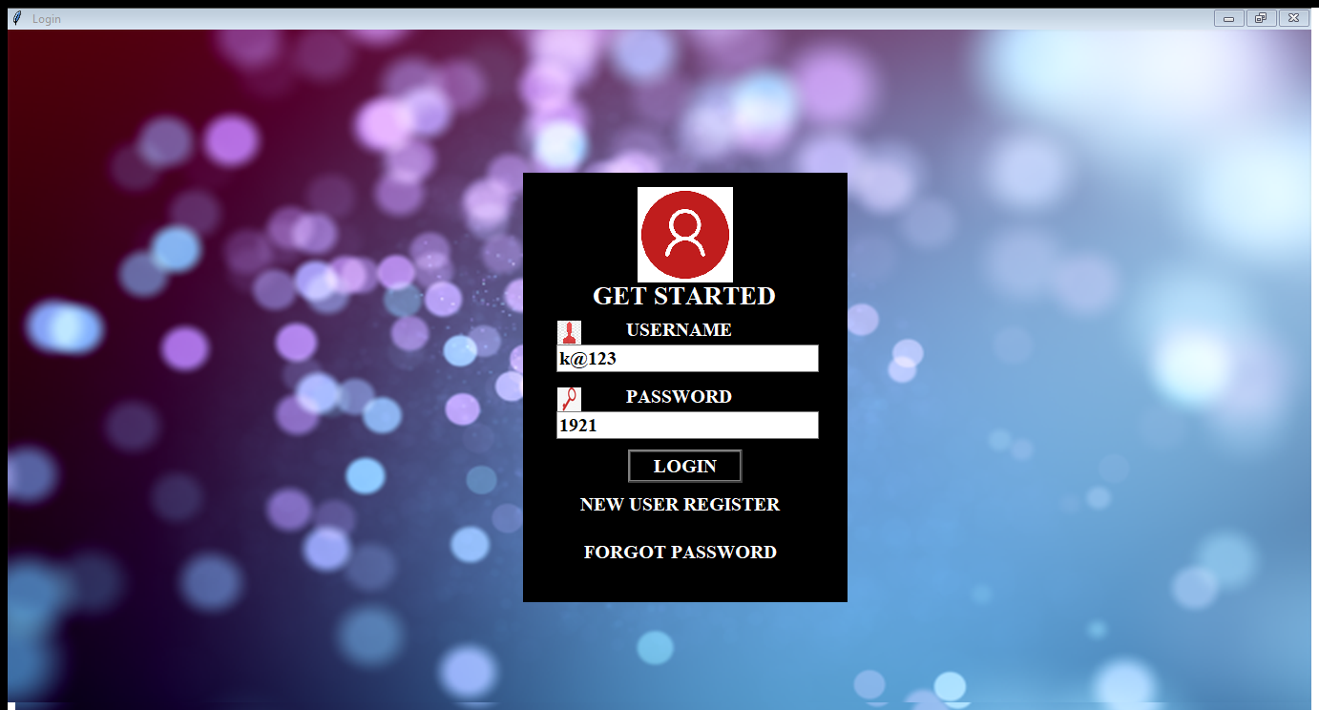
Login form
This Login form is whole designed in Python Programming language. This login form works normally form but has validations on Password. If you enter a valid username which is your email that you use while registering as a new user and password it redirects you to the project interface otherwise you will get a error message of wrong details and does not take you anywhere. It checks the registered user data and than allows to login

Slide 8
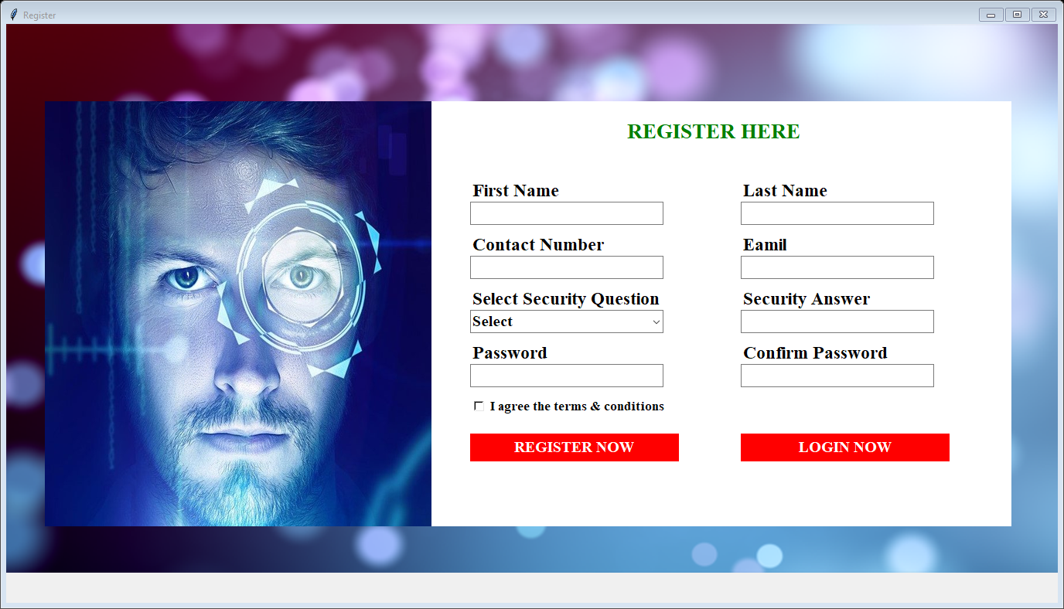
Registration form
In this registration form user will enter the required fields and here the user email and password are used for login. This user registration comes with one condition only one email can be used for registering. No data repetition is allowed. This form contains all the user validations

Slide 9
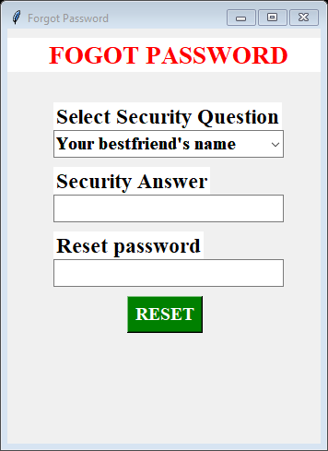
Reset password
The Reset Password allows the user to reset their password by selecting the exact security question and security answer no fishing can be done here in this form

Slide 10
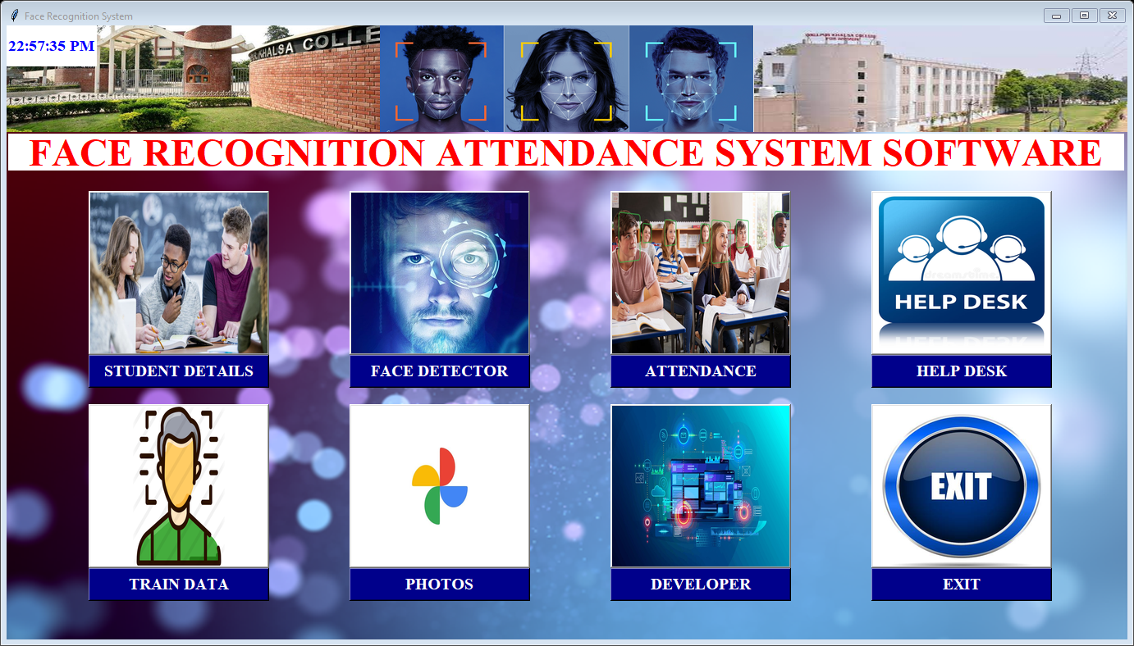
Project interface
This is our project’s interface or we can say it is our main frame when we close this frame we get redirected to the login form again.
It contains a time clock at the left top corner. It have eight buttons on it which have their own response when we click on them. These are explained in next slides

Slide 11
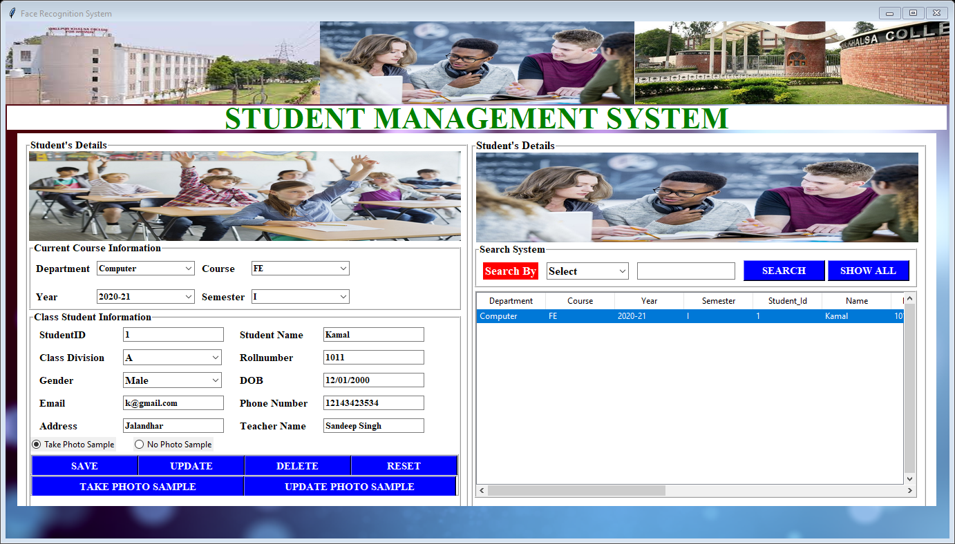
Student details button
When we click on the Student Detail’s Button it will take user to a form page which have many input entry fields and also some combo buttons the whole page is divided in two frames the one for registering data of student and second frame represents data in the database in backend.
It has all responsive button to DELETE, UPDATE, SAVE , RESET and TAKE PHOTO SAMPLE buttons.
In this page the student get clicked their face images to be stored in the photos file which are being used for Face Recognition.

Slide 12
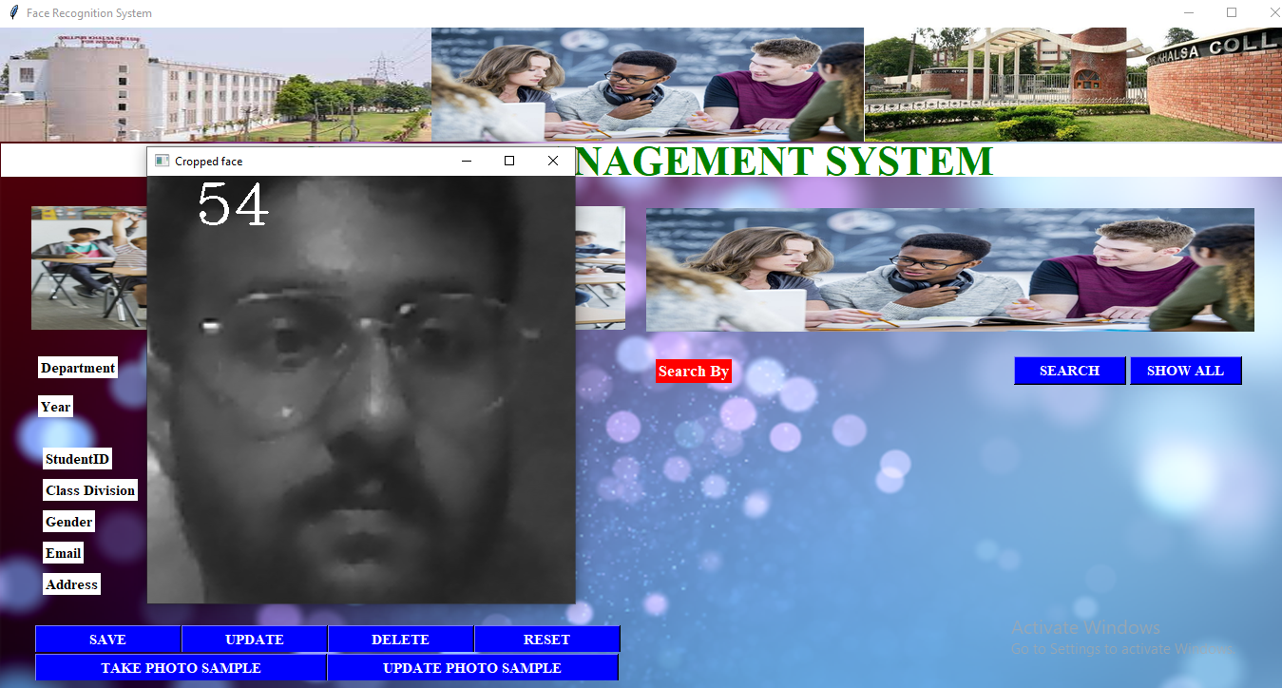
face recognition button
This button is present in the student details button which take 100 image samples of the student to match for future purpose

Slide 13
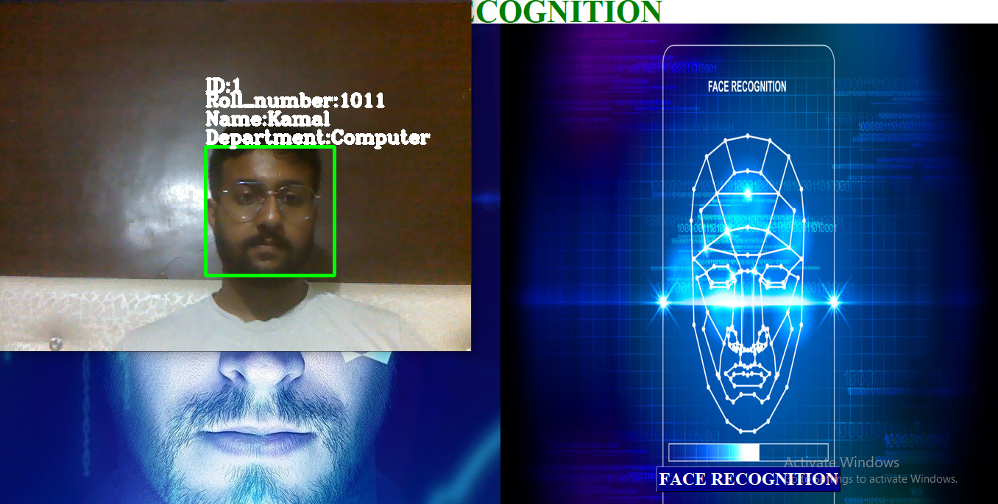
Face detection button
It will detect the face of the student to being marked in their attendance CSV sheet.
The student can mark their attendance for only once in a day

Slide 14
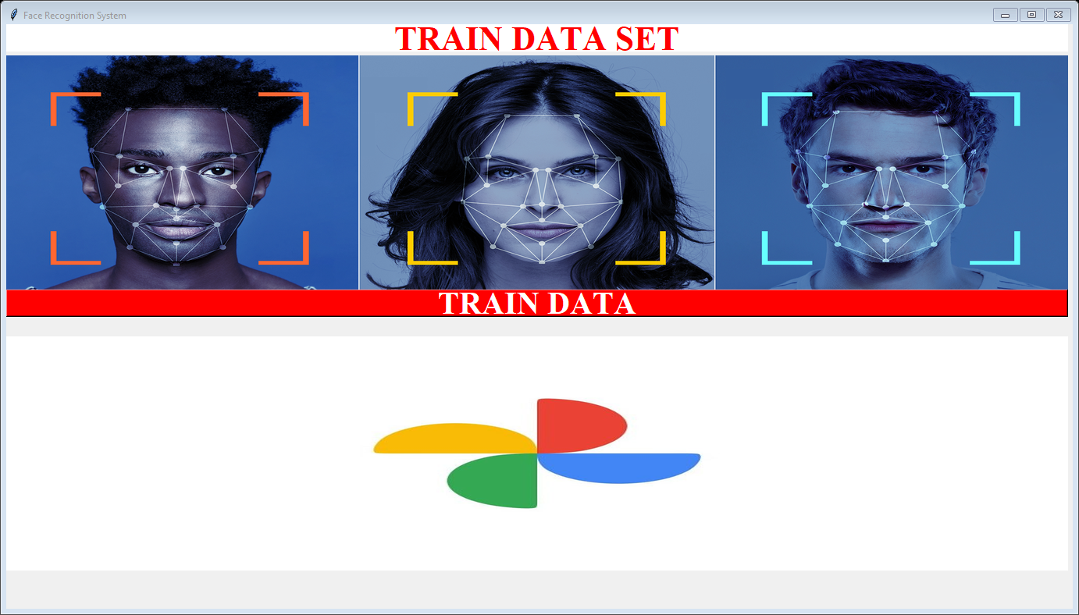
Train data button
Before Face Recognition we need to Train the detection software didn’t work properly.
When we train the data it stores the every possible point our face then store the points in the classifier.xml file. Then it shows a confirmation message “data training has been completed “

Slide 15
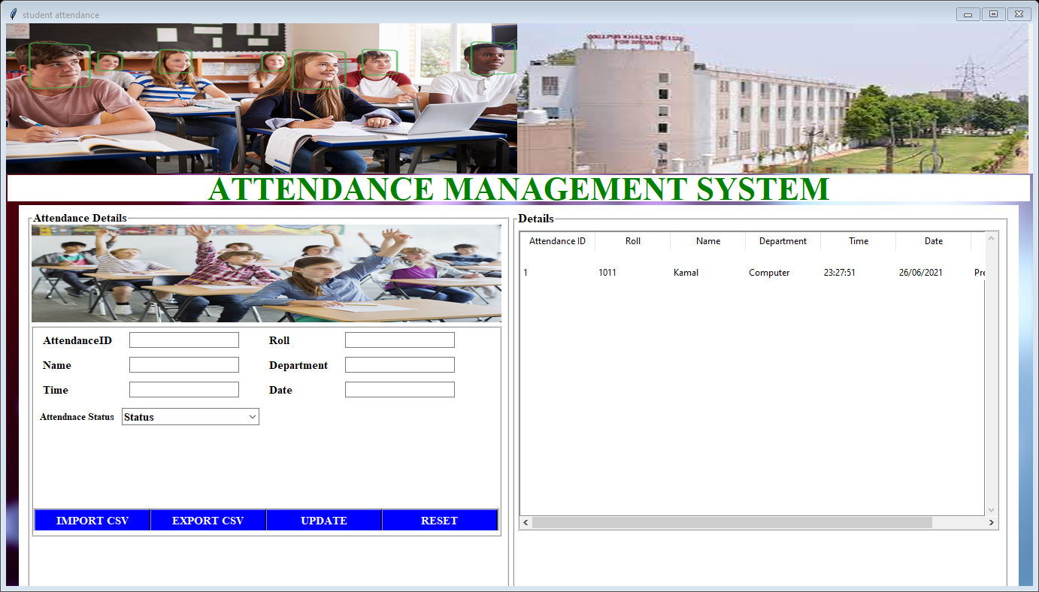
Attendance button
The Attendance Button is namely clear that it is being used to see the student’s attendance which is stored in a csv file which we need to import first.
It have buttons like IMPORT CSV, EXPORT CSV, UPDATE and RESET . Data which is stored in the csv file when imported is shown up in the right frame

Slide 16
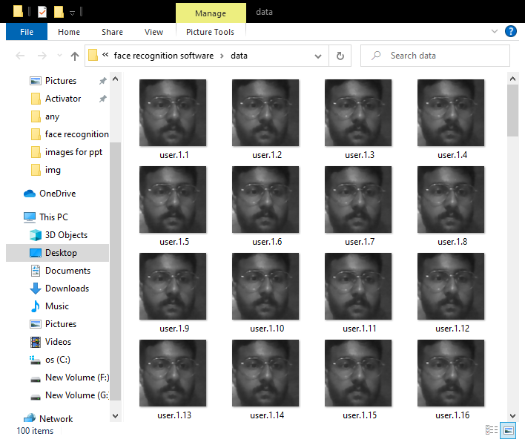
Photos button
By clicking on photos button an interface which have 100 samples of the student image which is stored in a folder named “data” shown up

Slide 17
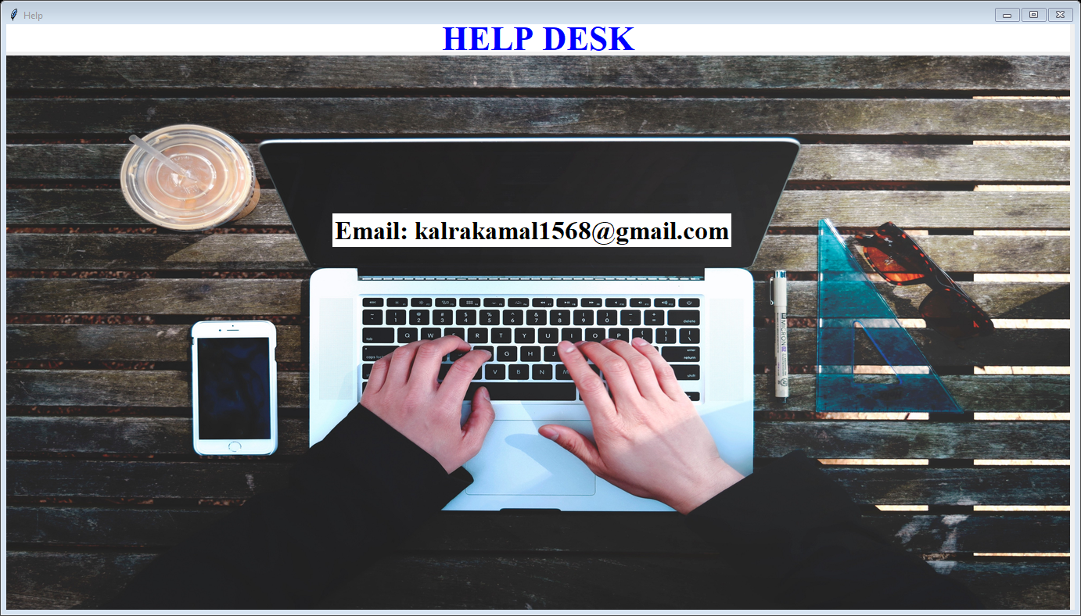
Help desk button
This button just used to redirect the user to a help desk frame in which images and a email is provided for user to send their queries in mails form

Slide 18
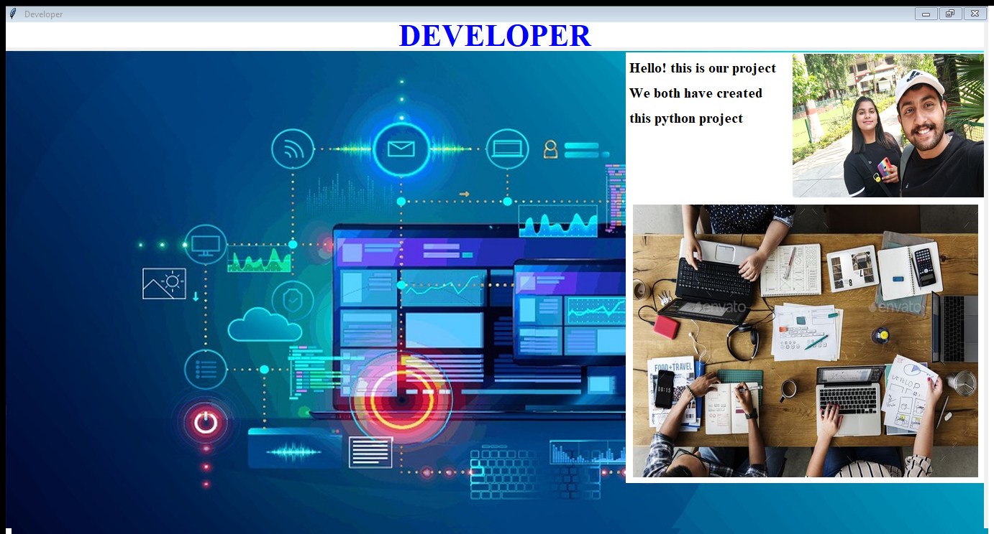
Developer button
It is also a simple page with a frame in which images of the developers of this python based software is given with introductory text for user

Slide 19
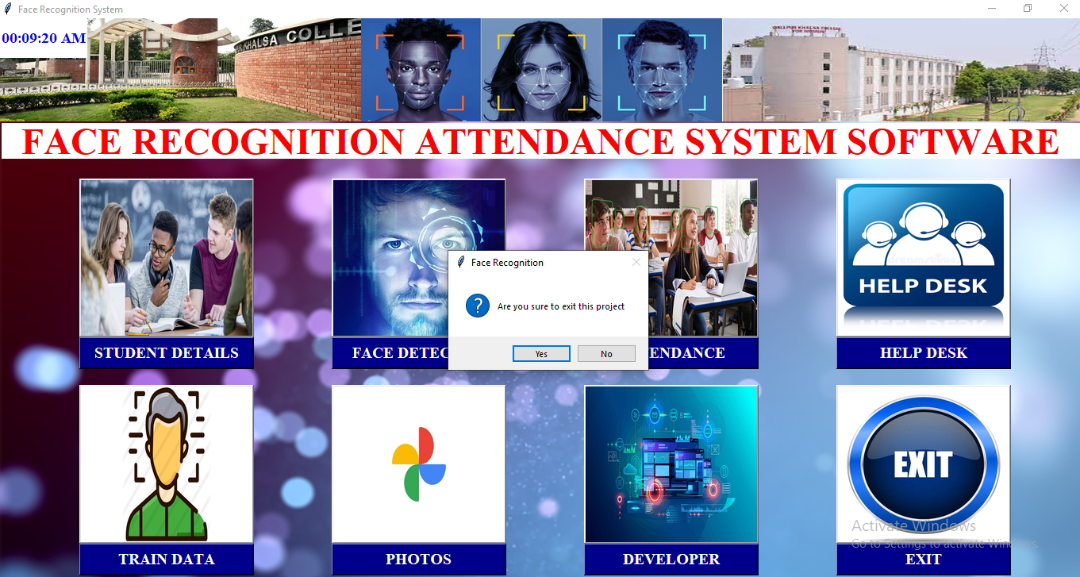
Exit button
When we click on the exit button software shows a yes or no option box on the screen. If the user click on the yes button it will redirect user to the login page otherwise it will return user on the same page

Slide 20
Project at the glance
The basic idea that we have used for making this project is taken up from our smart phones which provide us face Detection and Recognition features. This is basically a proper use of machine learning and AI technology.

Slide 21

Thank you for giving us your precious time
With regards from python developers
Kamal kalra & jasdeep kaur

